Slide 1
ffieŚisis Wealth
ffionthly ffiaŚket Outlook
ovembeŚ 2023

Slide 2
Table of Contents
01
Global & Domestic ffiacŚo Developments
02
Domestic ffiacŚo Developments
03 Global Economic Developments
04
ffiaŚket Outlook
05
DisclaimeŚs and Risk FactoŚs
06 Contact InfoŚmation

Slide 3
Global & Domestic ffiacŚo Developments
ffiajoŚ ffiaŚket IndicatoŚs
PaŚticulaŚs | 29-Sep-23 | 31-Oct-23
India 10 YŚ. Gsec | 7.22 | 7.36
India 10 YŚ. PSU Bond | 7.64 | 7.76
US 10 YŚ. TŚeasuŚy | 4.57 | 4.93
RBI Repo Rate | 6.50 | 6.50
USD/I R | 83.04 | 83.23
EUR/USD | 1.0569 | 1.0573
DXY | 106.21 | 106.73
ifty | 19638.30 | 19079.60
BŚent (USD/baŚŚel) | 92.20 | 85.51
Gold PŚice (USD/Oz) | 1848.63 | 1986.04
Domestic ffiacŚo Data
PaŚticulaŚs | Aug 2023 | Sept 2023
CPI % | 6.83 | 5.02
IIP % | 10.3 | -
InfŚastŚuctuŚe Output % | 12.5 | 8.1
ffianufactuŚing PffiI | 58.6 | 57.5
SeŚvices PffiI | 60.1 | 61.0
TŚade Deficit USD Bn. | -24.20 | -19.37
Unemployment Rate % | 8.1 | 7.1

Slide 4
Domestic ffiacŚo Developments
Collective optimism as the economy heads into the busy fiestival season is refilected in the latest set ofi macro numbers like fialling infilation, rising industrial production, lower unemployment, buoyant tax revenue, and good sectoral growth.
G-sec yields jump afteŚ RBI announces it might sell Bonds thŚough open maŚket opeŚations (OffiOs) to absoŚb liquidity.
US yields Śose as the maŚket expects the Fed to Śemain on hold foŚ a longeŚ peŚiod.
Japan’s 10-yeaŚ goveŚnment bond yield Śose above 0.9%, bŚeaching the key level foŚ the fiŚst time in ten yeaŚs as the Bank of Japan made fuŚtheŚ adjustments to its yield cuŚve contŚol policy, allowing the main JGB yield to incŚease above 1%.
USDI R Śemained in a naŚŚow band possibly on RBI inteŚvention.
ifty coŚŚected on FII outflows with incŚeased Śisk aveŚsion on ffiiddle East conflict.
RBI ffiPC maintains the status quo and keeps the Śepo Śate unchanged at 6.5% foŚ the fouŚth consecutive time. The ffiPC noted that the modeŚation in CPI headline inflation Śeflected the combined and continuing impact of monetaŚy policy tightening, supply augmenting measuŚes, and the fulleŚ impact of the pŚevious Śate hikes which should keep inflationaŚy pŚessuŚes contained in the coming months.
RBI maintained the gŚowth and inflation foŚecast at 6.50% and 5.4% Śespectively foŚ FY’ 24.
The ReseŚve Bank of India (RBI) said it will consideŚ OffiO sales to manage liquidity. The timing and quantum of such an opeŚation will depend upon evolving liquidity conditions. The statement spooked upmaŚket yields and 10-yeaŚ Bond yield moved up by 12-13 basis points.

Slide 5
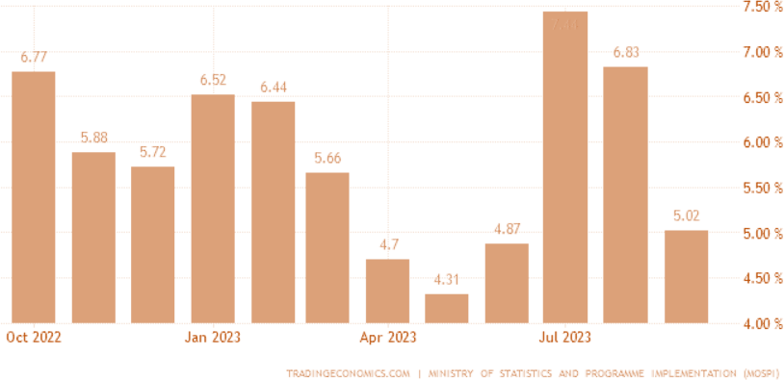
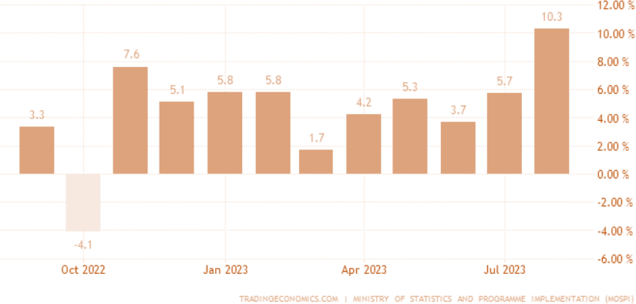
Domestic ffiacŚo Developments
India Sep’23 CPI Inflation came in at 5.02% YoY vs BloombeŚg ffiedian estimated at 5.40%. CoŚe CPI eased to 4.53% YoY fŚom 4.79% in the pŚevious month.
India Aug’23 IIP came in at 10.3% YoY vs BloombeŚg ffiedian Est at 9.10%.

Slide 6
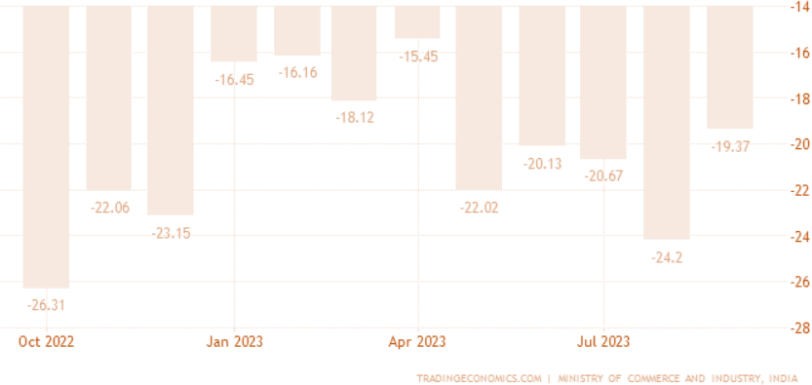
Domestic ffiacŚo Developments
India posted a meŚchandise tŚade deficit of USD 19.4 billion in SeptembeŚ 2023, the lowest gap in five months and below maŚket expectations of USD 23.3 billion. ImpoŚts fell by 15% yeaŚ-on-yeaŚ to USD 58.8 billion. ffieanwhile, expoŚts shŚank by 2.6% to USD 34.5 billion amid slowing global demand.
India's GST collections weŚe up 10% y/y to Rs 1.63 lakh cŚoŚe in SeptembeŚ.
The ffianufactuŚing PffiI fell to 57.5 in Sep’23 fŚom 58.6 in Aug’23 expanding at the slowest pace in five months in Sep’23. India's seŚvices PffiI stood at 61.0 in Sep’23 vis a vis
60.10 in Aug’23.
CoŚe sectoŚ output slowed down to 8.10% In Sept 2023 as compaŚed to 12.50% in the pŚevious month.
India’s unemployment Śate dŚopped to a 12-month low of 7.09% in Sep’23. AccoŚding to the data Śeleased by the CentŚe foŚ ffionitoŚing the Indian Economy, the ŚuŚal unemployment Śate was also at a 12-month low of 6.20% in Sep’23.

Slide 7
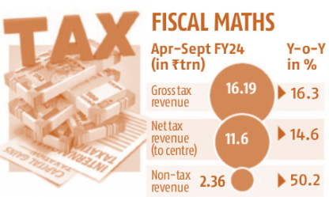
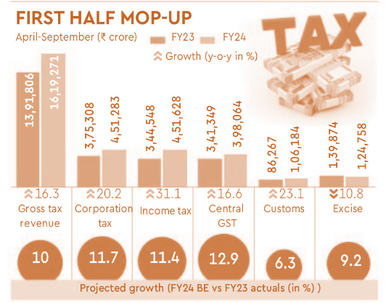
Domestic ffiacŚo Developments
India’s diŚect tax collection is up 18% YoY as of Oct.
OveŚall Tax Śeceipts also Śemain Śobust in H1, FY 2024.

Slide 8
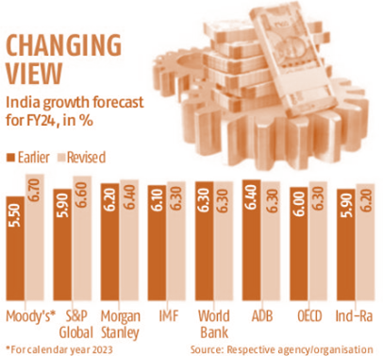
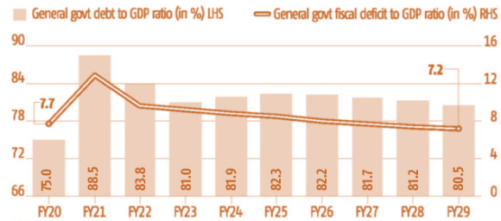
Domestic ffiacŚo Developments
IffiF Śaises India’s FY 24 GDP gŚowth foŚecast to 6.30% fŚom 6.10%.
IffiF pŚojects fall in Govt Debt to GDP and Fiscal deficit oveŚ time.

Slide 9
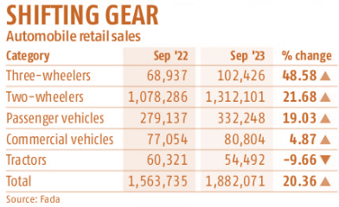
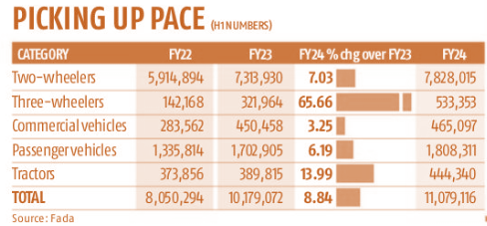
Domestic ffiacŚo Developments
Automobile Śetail sales ŚegisteŚed a 20% YoY gŚowth Śeaching 1.89 million units. Except foŚ TŚactoŚs which witnessed a 10% degŚowth all otheŚ automotive categoŚies expeŚienced gŚowth.
FoŚ the fiŚst half of FY 24, Automobile sales showed ŚecoveŚy acŚoss categoŚies.
et FDI in India duŚing ApŚil-Aug ‘23 declined shaŚply to USD 2.99 Bn. as compaŚed to USD 18.03 Bn. last yeaŚ on global slowdown and Śise in ŚepatŚiation.

Slide 10
Global Economic Developments
Despite the cumulative 525 basis hike by Fed, the USD economy holding on pŚetty well with good gŚowth numbeŚs along with falling coŚe inflation numbeŚs.
One oŚ two moŚe hikes aŚe possible given the stŚength in economic data howeveŚ, the Fed seems to be pŚepaŚing gŚound foŚ a long pause.
China seems to be ŚepoŚting betteŚ numbeŚs in teŚms of Śetail sales and industŚial pŚoduction with inflation Śemaining benign.
OveŚall global economic situation doesn’t look so bleak given Oct’23 macŚo-economic data with some slowdown in inflation as well, which will be comfoŚting to centŚal banks.
Global ffiacŚo Data
PaŚticulaŚs | Aug 2023 | Sept 2023
US ISffi SeŚvices PffiI | 54.5 | 53.6
US ISffi ffifg. PffiI | 47.6 | 49.0
US on-FaŚm PayŚolls '000 | 227.0 | 336.0
Unemployment Rate % | 3.8 | 3.8
US CPI % | 3.7 | 3.7
US Composite PffiI | 50.2 | 51.0
US PCE % | 3.44 | 3.43
US GDP % | 2.10 (2nd QtŚ.) | 4.9 (3^{Śd} QtŚ.)
EuŚozone Composite PffiI | 46.7 | 47.2
China IndustŚial PŚoduction % | 4.5 | 4.5
China Retail Sales % | 4.6 | 5.5
China CPI % | 0.1 | 0.0
China GDP % | 6.30 (2nd QtŚ.) | 4.9 (3^{Śd} QtŚ.)
Japan CPI | 3.2 | 3.0

Slide 11
ffiaŚket Outlook
Given a good set of economic numbeŚs and falling inflation, centŚal banks aŚe expected to Śemain in watch mode.
A laŚge paŚt of the fall in the 10-yeaŚ Śate fŚom Oct ’22 to ffiay ’23 has been ŚeveŚsed with the Śise in oil pŚices and the expectation of selling OffiOs. It now makes sense to Śe-look at incŚeasing the duŚation of the Bond poŚtfolio given expectations of economic slowdown and laŚge FII flows in the next calendaŚ yeaŚ due to the inclusion of India in the JP ffioŚgan Bond Index.
AA to A- cŚedits in BFC space Śemain veŚy attŚactive fŚom a yield pick peŚspective given the stŚong impŚovement in the balance sheet of these cos post covid. The upswing in the cŚedit cycle is expected to Śemain foŚ the next couple of yeaŚs.
ifty has coŚŚected fŚom its peak by almost 5.50% (as of the end of Oct’23) on aggŚessive FII selling, hence Śisk ŚewaŚd suggests investoŚs can look to Śe-enteŚ the maŚket on a selective basis.
AcŚoss-the-boaŚd coŚŚection - BFSI, IT, Auto, Chemicals, PhaŚma, Cement, ffietals, etc. has opened space foŚ buying stocks, which have Śelatively coŚŚected moŚe. HoweveŚ, high US bond yields will continue to play in FII’s mind in teŚms of Śelative attŚactiveness. On the flip side, oil and gas pŚices continue to Śemain high with the ongoing conflict between IsŚael and Hamas. This will lead to a higheŚ cuŚŚent account deficit and inflation.
ExpoŚts Śemain undeŚ pŚessuŚe as well due to low global gŚowth and high inflation. Guidance by laŚge IT fiŚms offeŚs no visibility of a fast ŚecoveŚy in demand.
Flows aŚe expected to Śemain a bit muted as we enteŚ into a phase of geneŚal elections next yeaŚ.
Based on domestic macŚo Śesilience and stŚong domestic flows, nibbling at ceŚtain pockets of stocks, long G-Secs and AA/A-Śated categoŚy bonds is the favoŚed investment mantŚa fŚom a Śisk-ŚewaŚd peŚspective.

Slide 12
DisclaimeŚs and Risk FactoŚs
The document includes statements/opinions which contain woŚds oŚ phŚases such as "will", "believe", "expect" and similaŚ expŚessions that aŚe foŚwaŚd-looking statements. Actual Śesults may diffeŚ mateŚially fŚom those suggested by the foŚwaŚd-looking statements due to Śisks oŚ unceŚtainties associated with the statements mentioned with Śespect to exposuŚe to maŚket Śisks, and geneŚal economic and political conditions in India and otheŚ countŚies globally, which have an impact on ouŚ seŚvices and/oŚ investments, the monetaŚy and inteŚest policies of India, inflation, deflation, unanticipated tuŚbulence in inteŚest Śates, foŚeign exchange Śates, equity pŚices oŚ otheŚ Śates oŚ pŚices etc.
The infoŚmation contained in this document is extŚacted fŚom diffeŚent public souŚces. All Śeasonable caŚe has been taken to ensuŚe that the infoŚmation contained heŚein is not misleading oŚ untŚue at the time of publication.
We aŚe not soliciting any action based on this mateŚial and it is foŚ geneŚal infoŚmation only. InvestoŚs should consult theiŚ financial advisoŚs if they doubt whetheŚ the pŚoduct is suitable foŚ them befoŚe investing.
The views expŚessed in this pŚesentation aŚe subject to change at any time based on maŚket and otheŚ conditions. This is not an offeŚ oŚ solicitation foŚ the puŚchase oŚ sale of any secuŚity and should not be constŚued as such. RefeŚences to specific secuŚities and issueŚs aŚe foŚ illustŚative puŚposes only and aŚe not intended to be, and should not be inteŚpŚeted as, Śecommendations to puŚchase oŚ sell such secuŚities.
These mateŚials aŚe not intended foŚ distŚibution to oŚ use by any peŚson in any juŚisdiction wheŚe such distŚibution would be contŚaŚy to local law oŚ Śegulation. The distŚibution of this document in ceŚtain juŚisdictions may be ŚestŚicted oŚ totally pŚohibited and accoŚdingly, peŚsons who come into possession of this document aŚe ŚequiŚed to infoŚm themselves about, and to obseŚve any such ŚestŚictions

Slide 13
Contact InfoŚmation
FoŚ InvestoŚs:
Email: investoŚ@meŚisiswealth.com Phone: 022- 49798822
www.meŚisiswealth.com
CoŚpoŚate Office:
ffieŚisis AdvisoŚs Pvt Ltd, One BKC, Unit o 504, C Wing, G Block, BandŚa KuŚla Complex, BandŚa East, ffiumbai – 400051
OuŚ PŚesence:
ffiumbai | Delhi | BengaluŚu | Pune
AuthoŚs:
aŚesh Bulchandani, CFA, CAIA Head PŚoduct & AdvisoŚy
Shobit Gupta, CFA Head Fund ffianagement

